Slide 1




Introduction to Oracle
Oracle Database XE, APEX and Oracle SQL Developer
SoftUni Team
Technical Trainers
Software University
http://softuni.bg

Slide 2

Oracle Database
Overview

Slide 3
What is Oracle Database?
Oracle Database
World's leader in enterprise database systems
Powers big organizations, e.g. the financial sector
Designed for very large databases (exabytes of data)
Supports everything from the DB world
Transactions, stored procedures, big data, cloud, …
Very expensive, for big players only
Has a free version (Expression Edition – XE)

Slide 4
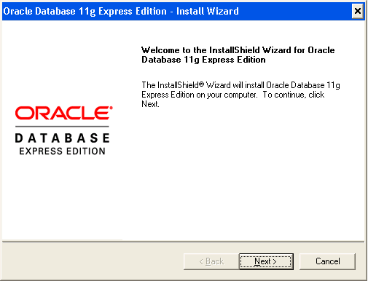
Oracle Database Express Edition (XE)
Oracle Database Express Edition (XE)
Free, limited version
1 CPU, 1 GB RAM, 11 GB storage
Installing Oracle Database XE
Download Oracle Database XE for Windows or Linux
Install it in a folder without spaces, e.g. C:\Progra~1\Oracle
Remember the admin password (for the users SYS and SYSTEM)

Slide 5
Oracle Database XE Services and Ports
Oracle XE services
OracleServiceXE
The Oracle database engine for the "XE" instance (SID)
The core of the Oracle database
OracleXETNSListener
Connects Oracle database with client applications (TNS service)
Listens on TCP port 1521 (TNS listener)
Holds the "Application Express" DB administration interface (APEX)
Listens on TCP port 8080 – http://localhost:8080

Slide 6
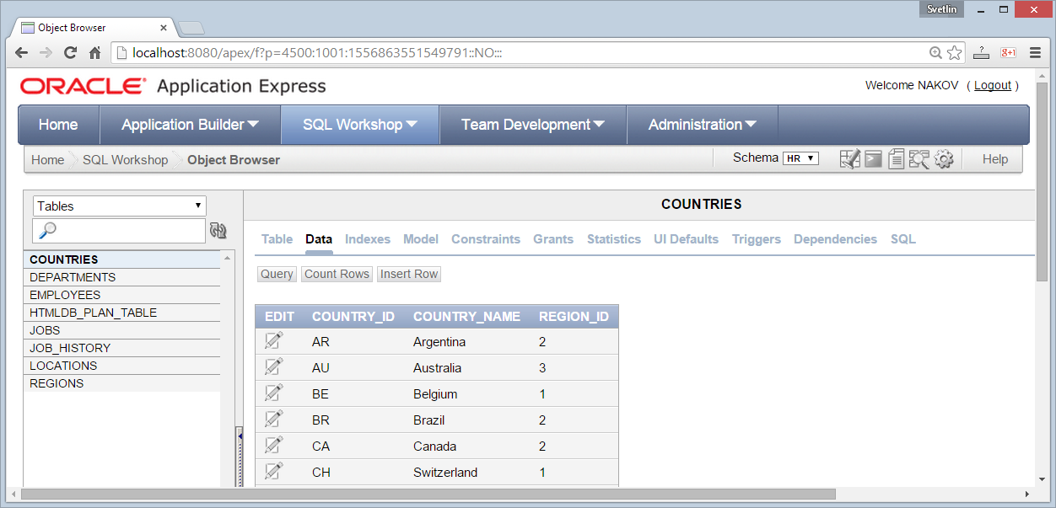
Oracle Application Express (APEX)
Oracle Application Express (APEX) – http://localhost:8080/apex
Web-based application for SQL developers & administration tool

Slide 7
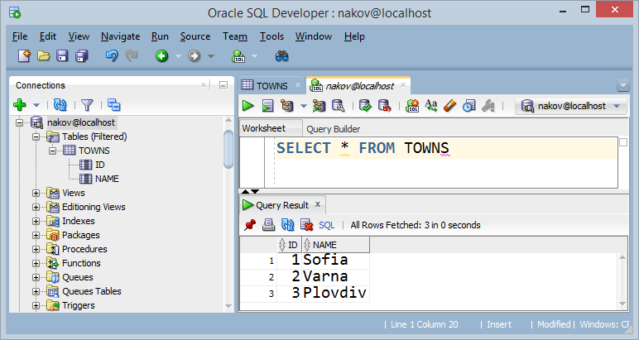
Oracle SQL Developer
Oracle SQL Developer is database GUI client tool for managing Oracle databases

Slide 8
Creating a New User
In Oracle we have single database with multiple users
Unlike many databases in MS SQL Server and MySQL
"User (schema) in Oracle" == "Database" in MSSQL and MySQL
Creating a new user (schema) and give typical privileges:
CREATE USER maria IDENTIFIED BY "p@ssw0rd123";
GRANT CREATE SESSION, CREATE TABLE, CREATE VIEW, CREATE PROCEDURE TO maria;
GRANT UNLIMITED TABLESPACE TO maria;

Slide 9
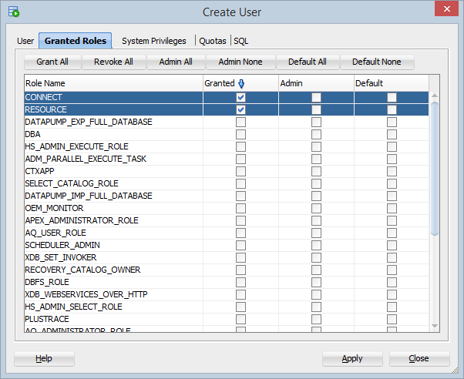
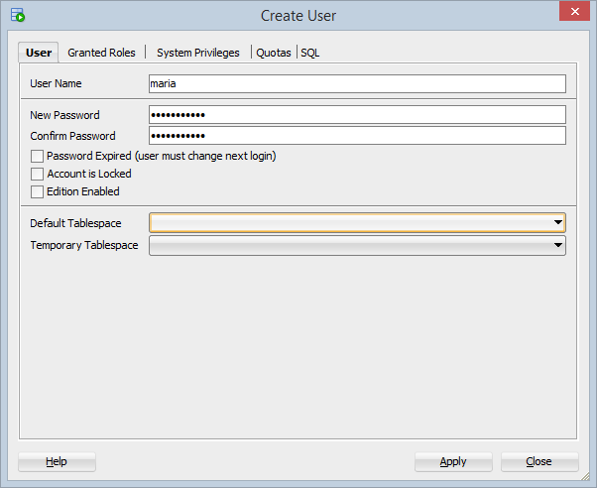
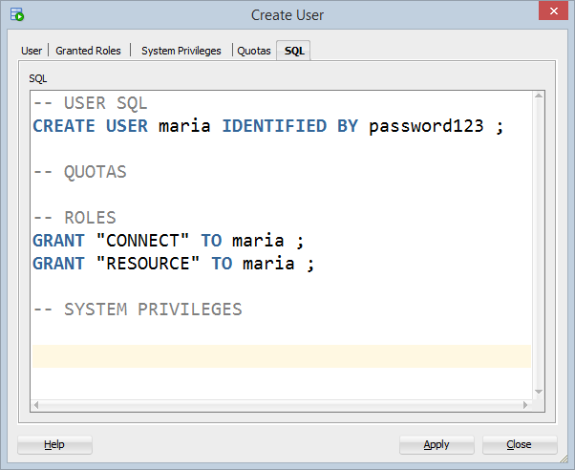
Creating a New User in SQL Developer

Slide 10
Beware: Oracle has Specifics
Oracle database has some specifics
One database, many users
Each user has its own schema (tables and other DB objects)
Use UPEPRCASE for all identifiers
Otherwise you should use the quoted syntax, e.g. "My Table"
No auto-increment columns
Use a SEQUENCE + TRIGGER for auto-increment
In Oracle NULL is the same like "" (empty string)
This causes many problems!

Slide 11



Summary
What is Oracle famous with?
Does it have a free version?
What is Oracle APEX?
What is Oracle SQL Developer?
How do we create a new user?
Databases

Slide 12







Introduction to Oracle
https://softuni.bg/courses/databases

Slide 13
License
This course (slides, examples, demos, videos, homework, etc.) is licensed under the "Creative Commons Attribution-NonCommercial-ShareAlike 4.0 International" license
Attribution: this work may contain portions from
"Databases" course by Telerik Academy under CC-BY-NC-SA license

Slide 14





Free Trainings @ Software University
Software University Foundation – softuni.org
Software University – High-Quality Education, Profession and Job for Software Developers
softuni.bg
Software University @ Facebook
facebook.com/SoftwareUniversity
Software University @ YouTube
youtube.com/SoftwareUniversity
Software University Forums – forum.softuni.bg

